Slide 1

Hi

Slide 2

SEB’S CAFÊ

Slide 3

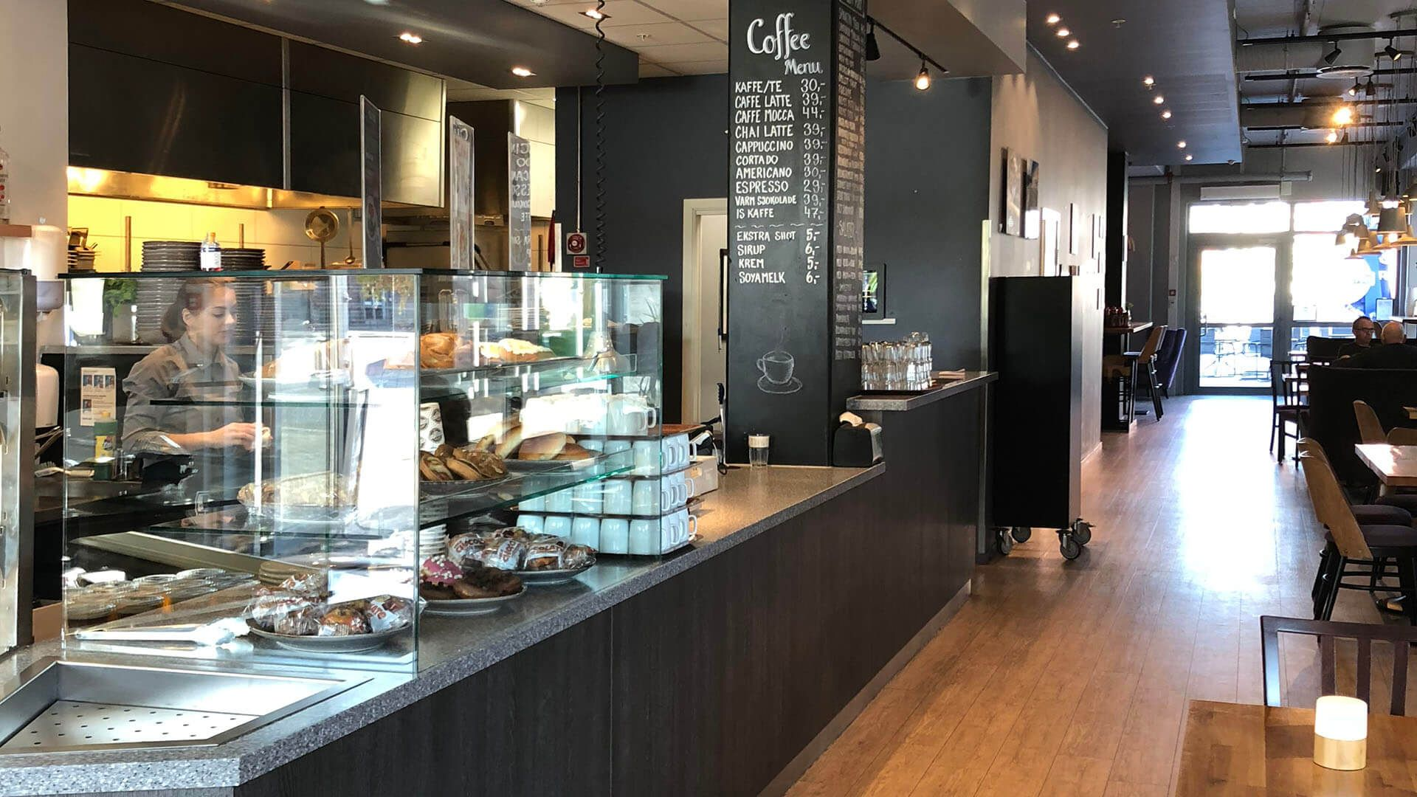
Who are we?
American coffeehouse and roastery
Coffeehouses in every state!
~ 1200 employees
We bring competition to the coffeehouses Industry!!

Slide 4
How?
Extreme efficiency + 512 million in profits
=
On avg 2 dollars cheaper per cup than the competitors!

Slide 5
We love our employees.
0 prejudices. We'll take you as you are!
Extremely competitive salary ladder for new hires
As well as many other company policie employee benefits

Slide 6
But …

Slide 7
Any questions?

